Slide 1

Payroll System Configuration Guide

Slide 2
Payroll System Configuration Guide
1
Monetary Units Configuration
2
Payment Methods Configuration
3
Payment Types Setup
4
Consolidation Sets
5
Payroll Definition
6
Element Definition
7
Element Links and Salary Bas

Slide 3
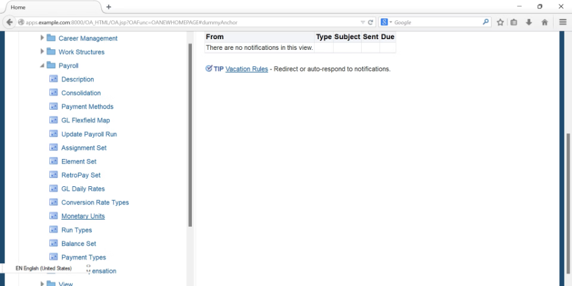
Monetary Units Configuration
Path: Payroll >> Monetary Units

Slide 4
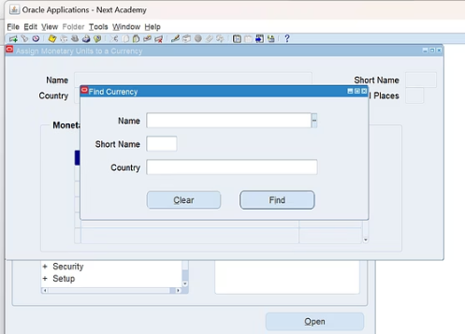
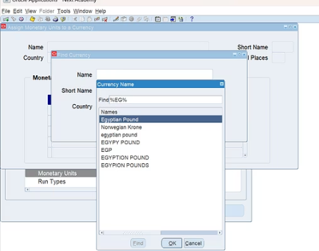
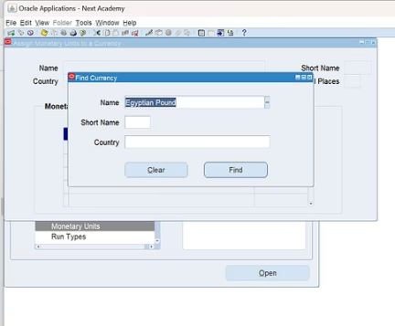
Find Currency

Slide 5
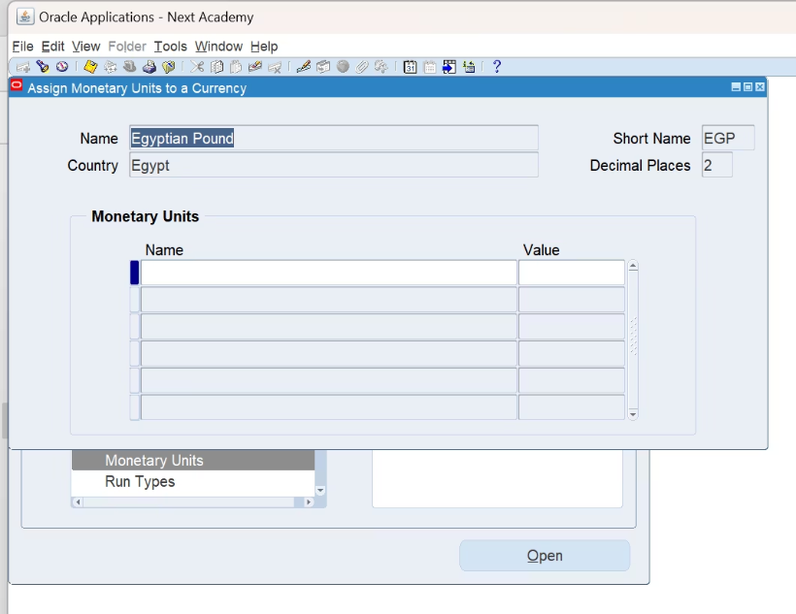
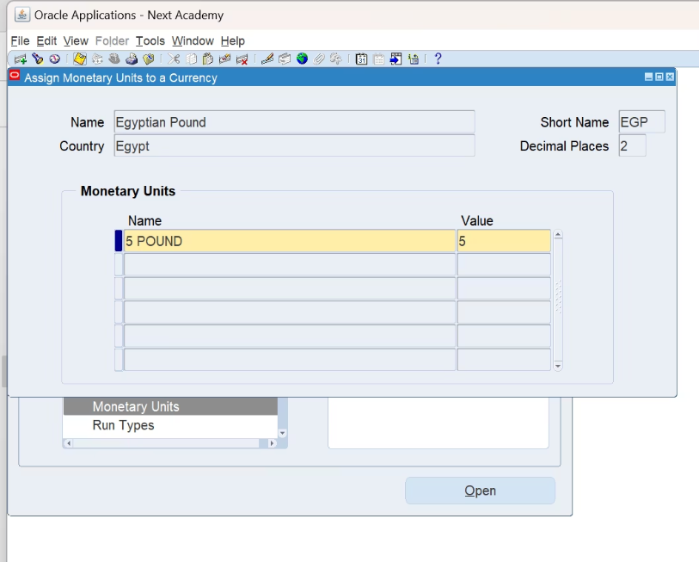
Define Currency Basics
Add Currency Denominations

Slide 6
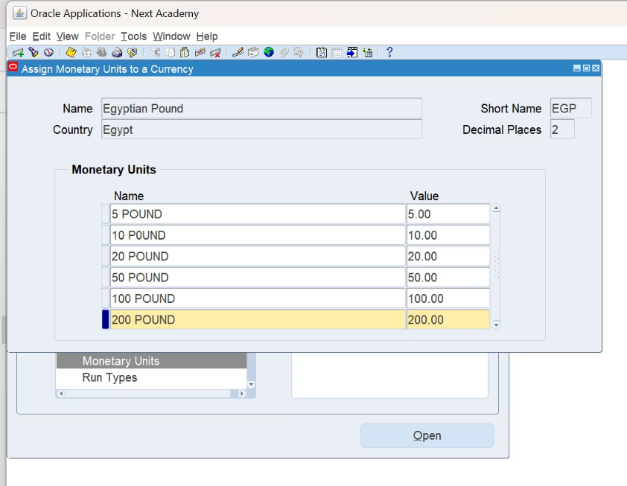
After entering Name (e.g., "5 POUND") and Value (e.g., "5.00"):
Click "Save" (or "Apply") button before adding the next unit.
Repeat for all denominations (10 POUND, 20 POUND, etc.).

Slide 7
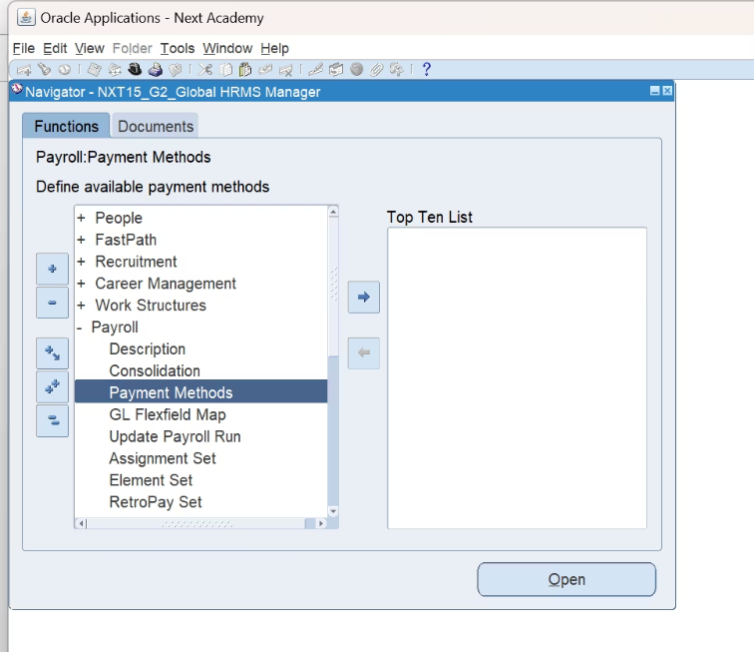
Payment Methods
path:
payroll > payment method

Slide 8
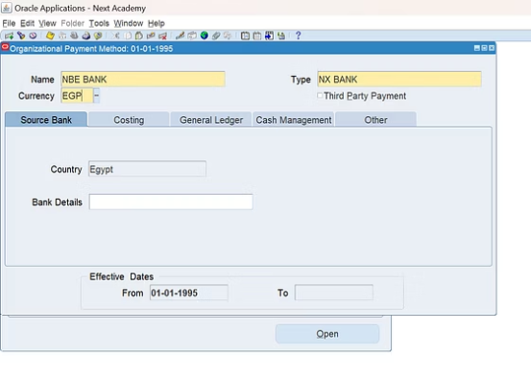
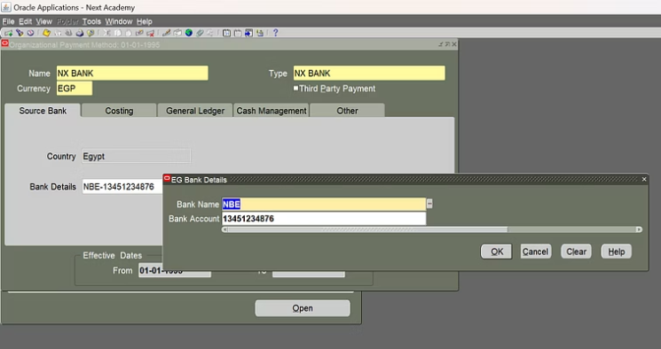
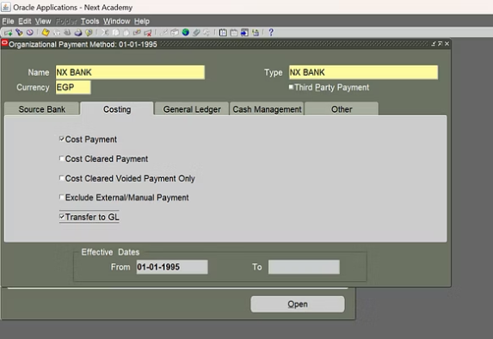
Bank Payment Method Setup

Slide 9
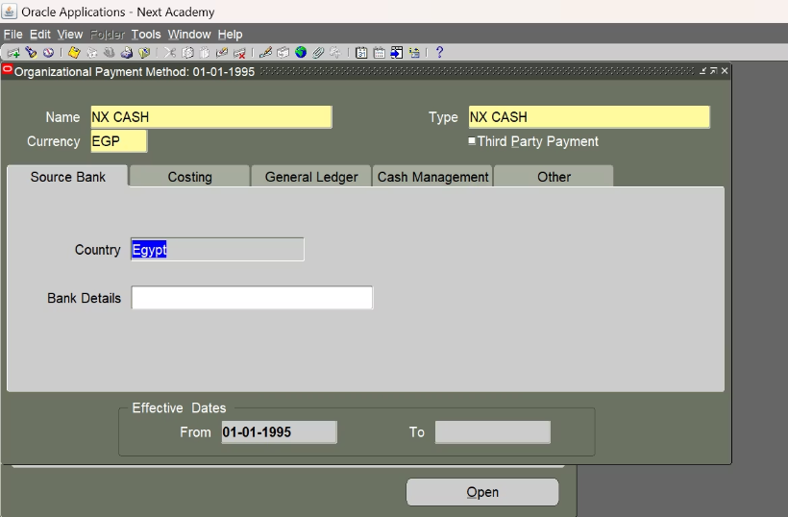
Cash Payment Method Setup

Slide 10
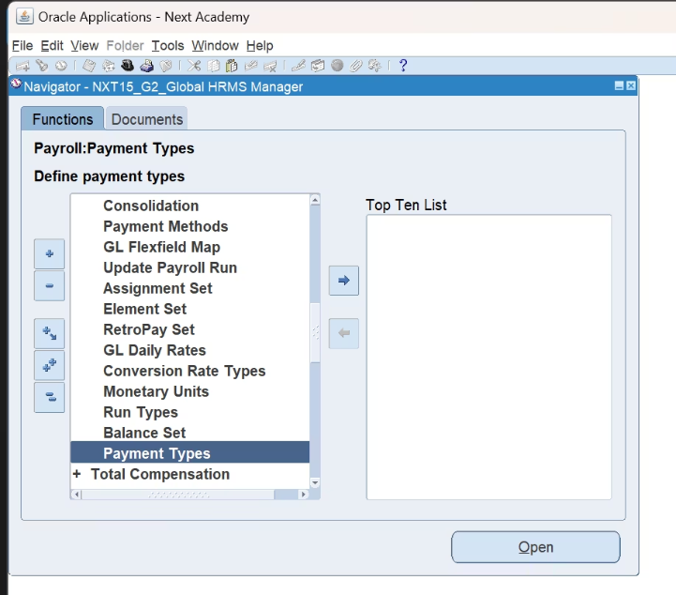
payment types
path:
payroll >payment types

Slide 11
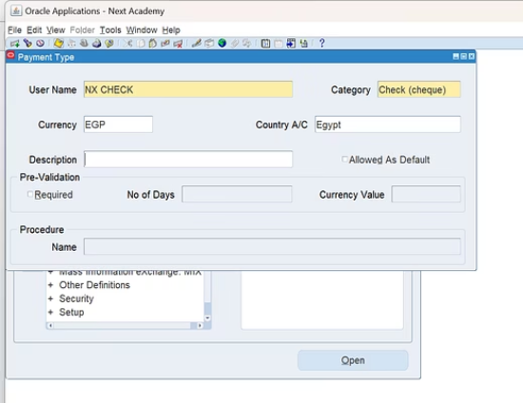
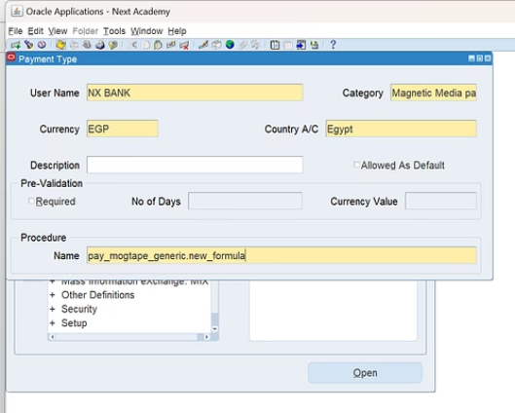
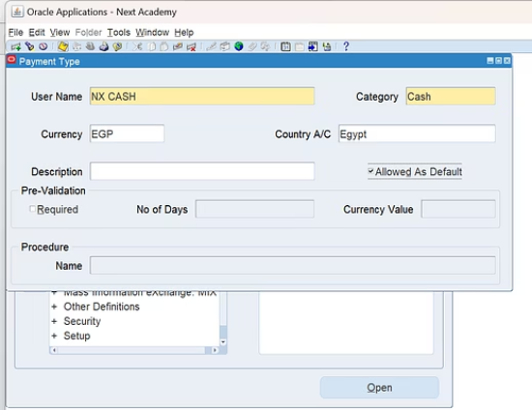

Slide 12
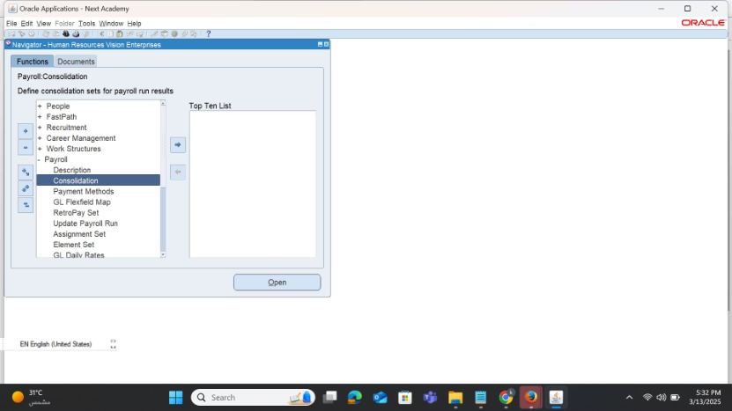
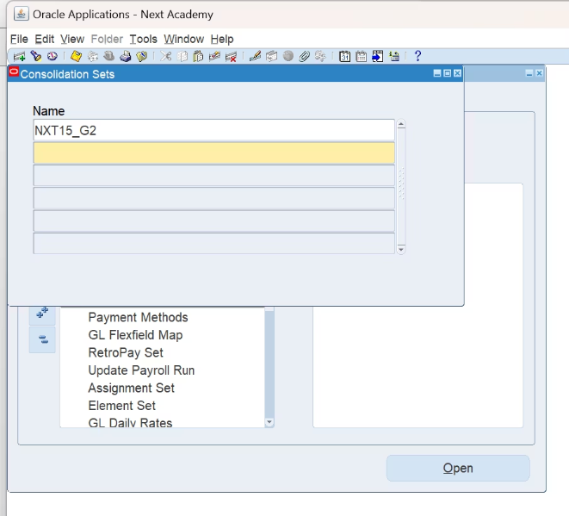
consolidation set
path: payroll>>consolidation

Slide 13
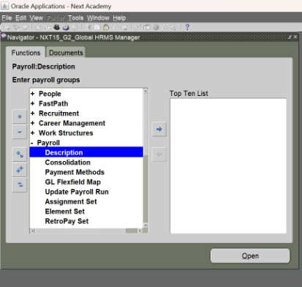
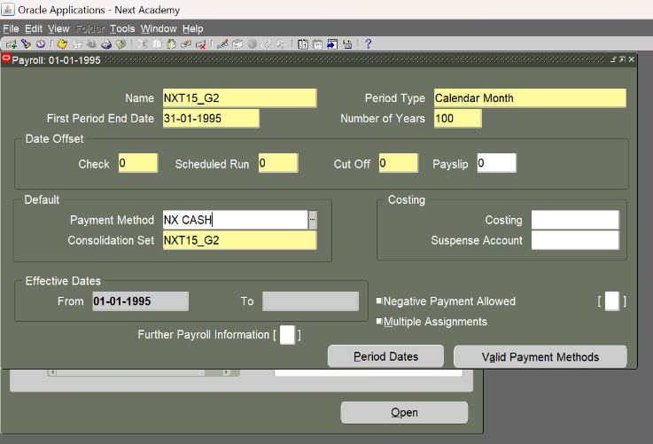
Define payroll
path:
payroll> description

Slide 14
Elements of Payroll
Basic Salary
Overtime NX
Parking
Tax
Gross Salary
Sick Leave
Absence
Accrual NX

Slide 15
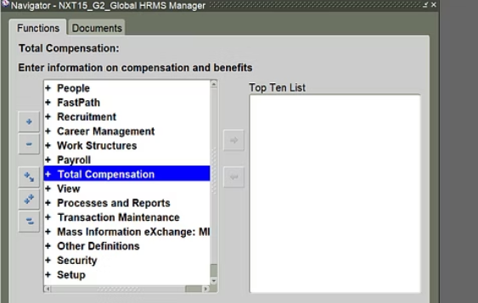
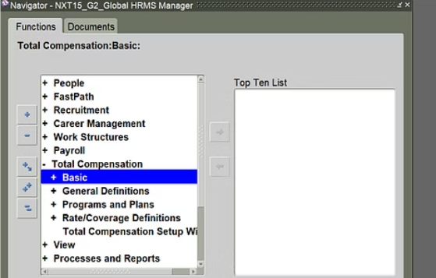
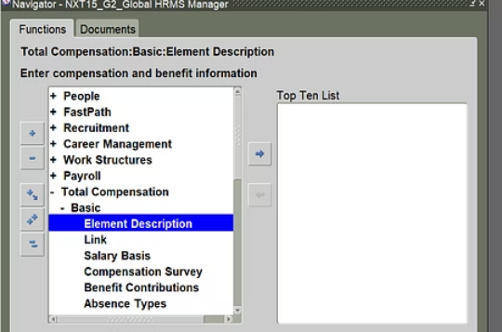
Define element
path: payroll>> description

Slide 16
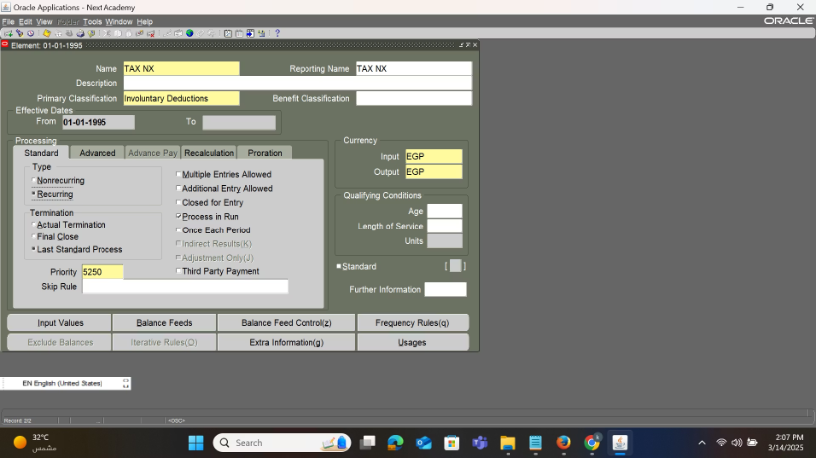
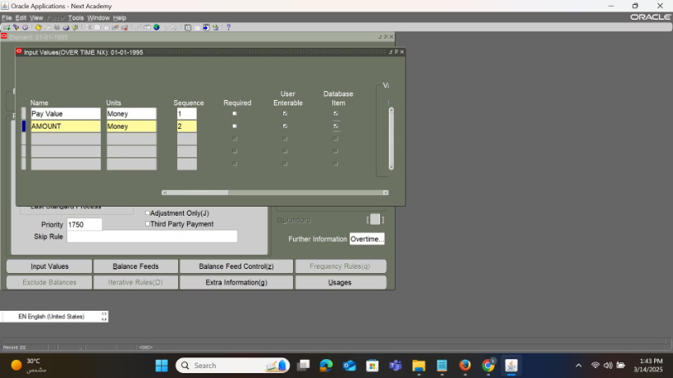
define element

Slide 17
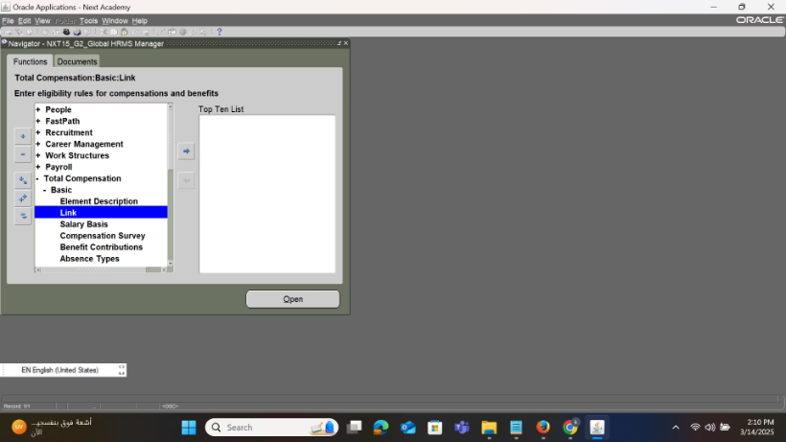
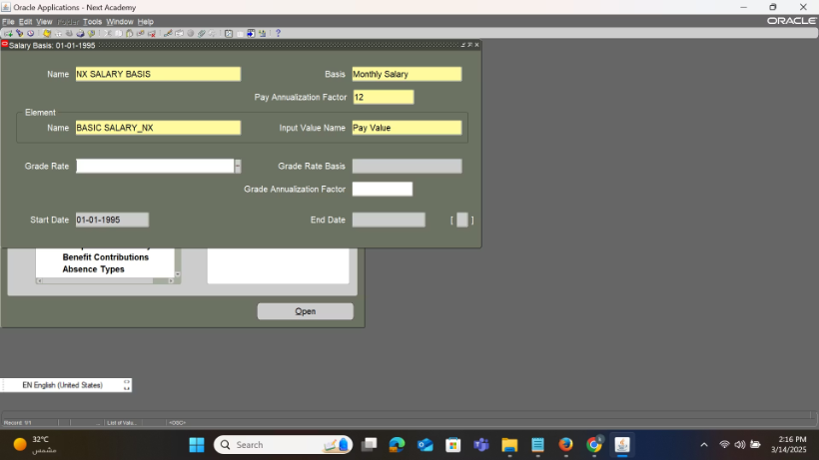
define salary basis
path:
total compensation >basic>salary basis

Slide 18
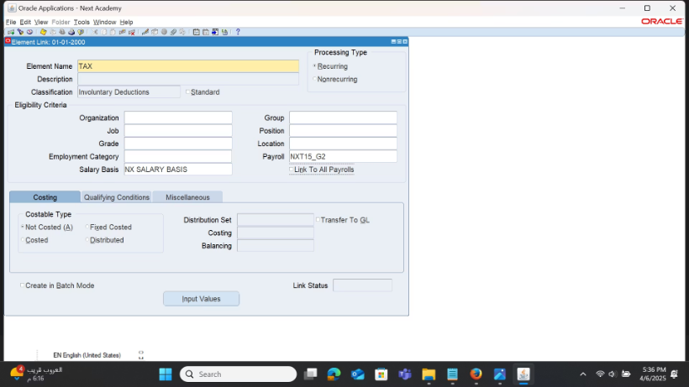
define element link
path:
total compensation>>basic>element link

Slide 19
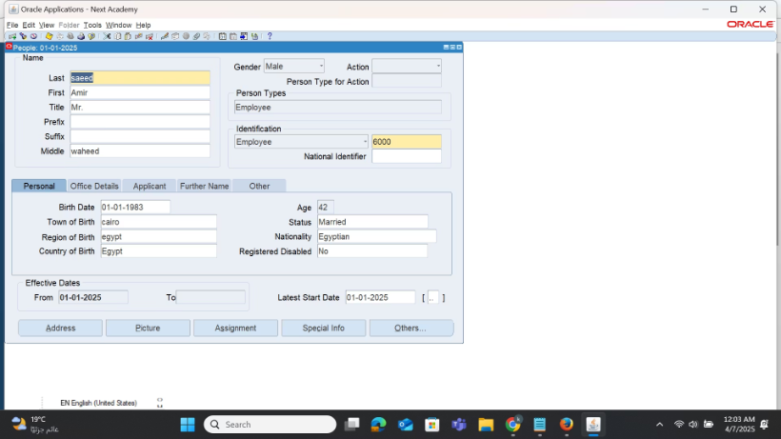
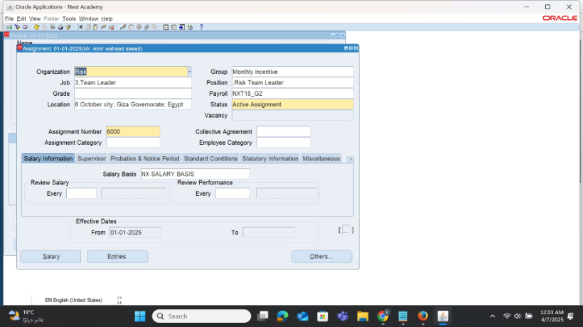
Linking the employee to the payroll
from people enter and maintain

Slide 20
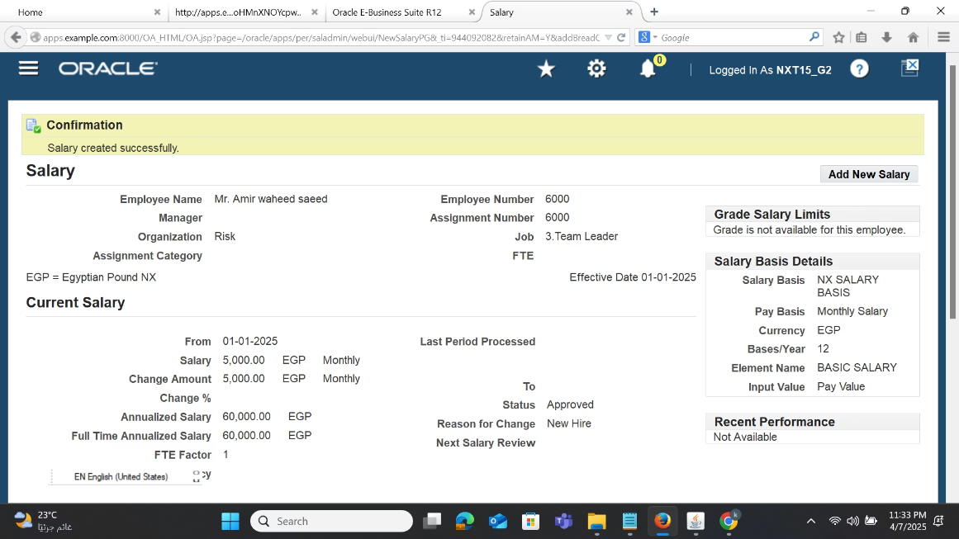
Add new salary

Slide 21
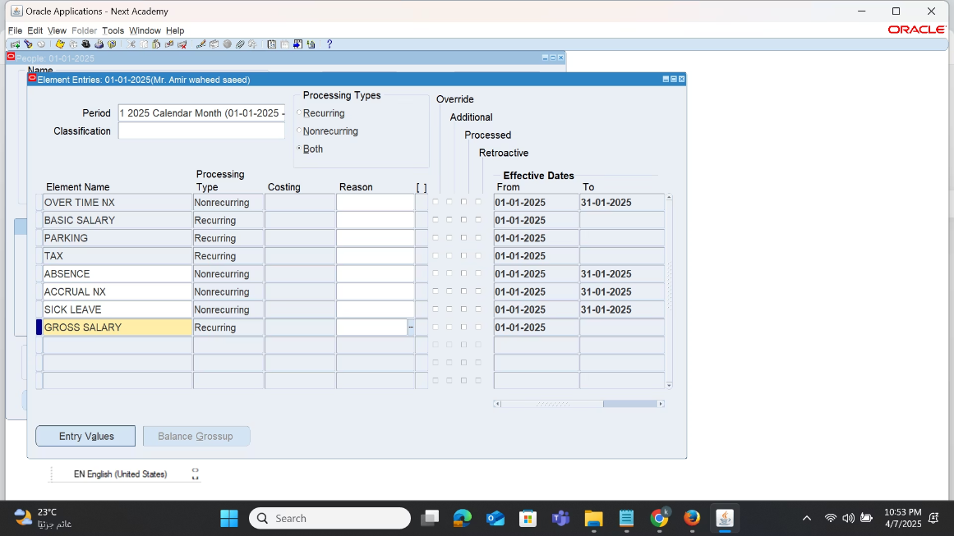
element entries

